Slide 1
F O R T I G A T E N E T W O R K S E C U R I T Y
VPN & IPsec VPN
Instructor: Mohamed Ibrahim
1
Sohaila Saeed
2
Yasmin Amgad
3
Aya Aboelhamed
4
Sandy Sadek
5
Jana Hady

Slide 2
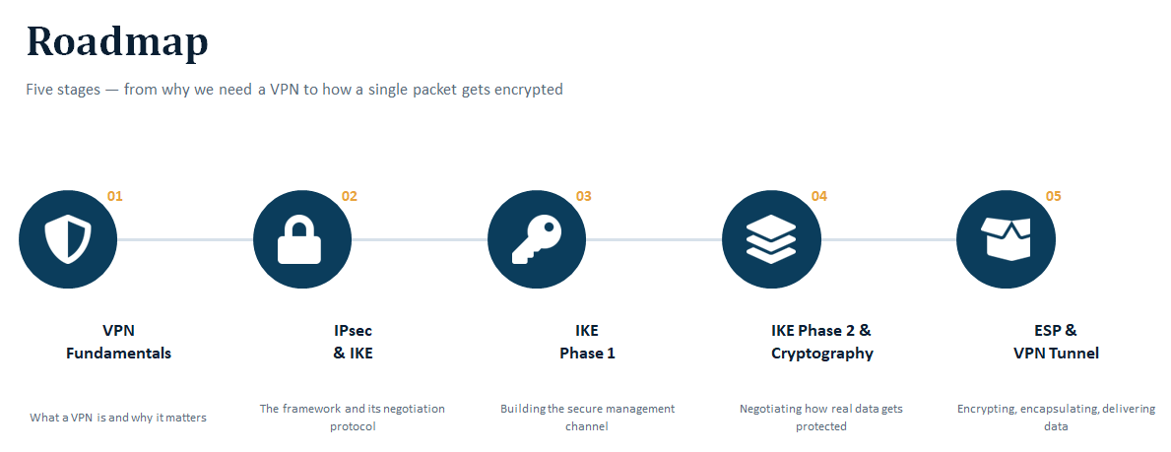
Five stages — from why we need a VPN to how a single packet gets encrypted
01
02
03
04
05
VPN
Fundamentals
IPsec
& IKE
IKE
Phase 1
IKE Phase 2 &
Cryptography
ESP &
VPN Tunnel
What a VPN is and why it matters
The framework and its negotiation protocol
Building the secure management channel
Negotiating how real data gets protected
Encrypting, encapsulating, delivering data
2

Slide 3
01 · FOUNDATIONS
What Is a VPN?
A Virtual Private Network creates a logical, secured tunnel across a shared or untrusted network — traffic behaves as if it travels over a private link.
1
2
3
Confidentiality
Integrity
Authentication
Encrypt payload so only the peer can read it (ESP).
Detect any modification in transit (HMAC).
Prove peer identity before trusting data.
3

Slide 4
01 · FOUNDATIONS
Why Use a VPN?
1
Site-to-Site Connectivity
Permanently join two trusted networks , across an untrusted path.
REAL-WORLD EXAMPLE
This lab's topology
2
Remote Access
R1 (HQ, 192.168.1.0/24)
needs to securely reach
R3 (Branch, 192.168.3.0/24)
across R2 — a router that simulates the public Internet and has no knowledge of the VPN.
A mobile user connects into the corporate network from anywhere.
3
Secure Communication Over Untrusted Networks
Replaces or protects traffic that would otherwise cross the public Internet or shared links in the clear.
4

Slide 5
01 · FOUNDATIONS
Types of VPN
BY TOPOLOGY
Site-to-Site
Remote-Access
Router/firewall-to-router/firewall. Used in this lab (R1 ↔ R3).
Client-to-gateway. On-demand, per-user tunnel (FortiClient ↔ FortiGate).
BY PROTOCOL / TECHNOLOGY
IPsec VPN
SSL/TLS VPN
Network layer (L3). Encrypts the IP payload. Focus of this presentation.
Transport/application layer. Common for remote access.
5

Slide 6
IPsec
IPsec Components
Securing IP Communications
I
IKE
Internet Key Exchange
Negotiates & establishes Security Associations (SAs)
Authenticates peers, agrees on algorithms
Derives keys via Diffie-Hellman — no keys sent on the wire
Layer 3 protocol suite that authenticates and encrypts every IP packet in a stream.
Provides:
Confidentiality · Integrity
Authentication · Anti-replay
A
AH
Authentication Header · Protocol 51
Integrity + authentication for the whole packet
No encryption — payload stays in plaintext
Breaks under NAT (protects outer IP header)
Largely legacy / rarely deployed alone today
E
ESP
Encapsulating Security Payload · Protocol 50
The workhorse of modern IPsec deployments
Confidentiality (encryption) + optional integrity
NAT-friendly — outer IP header left untouched
Transport mode (host-host) vs Tunnel mode (site-to-site)
SA · SPI · SPD/SAD
Core data structures that track how each packet is protected.
6

Slide 7
IKE
IKEv1 vs IKEv2
Why We Need Key Exchange
Message Exchange to Establish Tunnel
IKEv1
Main Mode (6 msgs, IDs encrypted) or Aggressive Mode (3 msgs, IDs exposed) + Quick Mode (3 msgs)
Without IKE, admins would manually configure & rotate encryption keys on every peer — insecure and unscalable.
IKEv2
IKE_SA_INIT (2) + IKE_AUTH (2) = 4 msgs, IDs always encrypted
IKEv1
Sets up the connection using either Main Mode (6 messages, slower but hides identities) or Aggressive Mode (3 messages, faster but exposes identities). Getting through NAT needs an extra add-on. Renewing keys means starting a whole new exchange (Quick Mode). No built-in protection against DoS attacks, and no support for switching networks mid-connection.
IKE automates:
Mutual peer authentication
Algorithm negotiation
Diffie-Hellman key derivation
SA lifetime & rekeying
IKEv2
Collapses setup into a fixed IKE_SA_INIT + IKE_AUTH exchange — 4 messages total — and always encrypts peer identities. NAT-T is native, and rekeying uses the lighter CREATE_CHILD_SA exchange instead of a full renegotiation. A mandatory guards against DoS floods, and MOBIKE lets a tunnel survive an IP change.
Two Phases
Phase 1 — secure, authenticated channel (ISAKMP SA)
Phase 2 — negotiates the IPsec SAs that protect data
Bottom line: IKEv2 is leaner and more resilient by design; IKEv1 (“crypto isakmp” on IOS) persists mainly for legacy peer interop.
2
7

Slide 8
03 · IKE NEGOTIATION
IKE Phase 1 — Building the Secure Channel
Establishes a mutually authenticated, encrypted control channel — the ISAKMP SA — before any negotiation about protecting real data begins.
PARAMETERS NEGOTIATED (crypto isakmp policy 10)
Encryption
Hash / Integrity
Authentication
DH Group
Lifetime
AES 256
SHA
Pre-shared key
Group 5
3600 sec
Both peers must agree on every value exactly — a single mismatch fails the negotiation. This is why R1 and R3 are configured with an identical policy.
8

Slide 9



03 · IKE PHASE 1
Building the ISAKMP SA
Phase 1 establishes the IKE SA, also called the ISAKMP SA — a secure, authenticated channel the peers will use to safely negotiate everything that follows.
1. Exchange ISAKMP Proposals
2. Run Diffie-Hellman Exchange
3. Authenticate & Activate
Peers propose encryption, hash, authentication method, DH group, and lifetime.
Peers derive a shared secret key together — without ever transmitting the key itself.
Peers confirm each other's identity and the ISAKMP SA becomes active.
Verify it: show crypto isakmp sa — look for state QM_IDLE and status ACTIVE
9

Slide 10

04 · IKE PHASE 2 & CRYPTOGRAPHY
Building the IPsec SA
Phase 2 runs inside the secure Phase 1 channel and negotiates the actual IPsec SAs that will protect real user data — for example, traffic from PC-A to PC-C.
Traffic Selectors (ACL)
Two Unidirectional SAs
An access list (e.g., ACL 101) defines exactly which source/destination traffic is "interesting" — only matching traffic triggers the SA and enters the tunnel.
One inbound and one outbound IPsec SA are created per direction, visible with show crypto ipsec sa.
Traffic Matches ACL
Phase 2 Negotiates
Transform Set
IPsec SA Becomes Active
(Tunnel mode)
10

Slide 11



04 · IKE PHASE 2 & CRYPTOGRAPHY
Cryptographic Building Blocks
AES (Advanced Encryption Standard)
SHA / HMAC
Provides confidentiality — scrambles data so only holders of the key can read it (e.g., AES 256).
Provides integrity — a hash proves data wasn't altered; HMAC ties the hash to a secret key so it can't be forged.
Confidentiality vs Integrity
Perfect Forward Secrecy (PFS)
Confidentiality asks "can anyone read it?" (solved by encryption). Integrity asks "was it tampered with?" (solved by hashing).
Forces a fresh Diffie-Hellman exchange for every new IPsec SA, so a compromised key never exposes past or future sessions.
In this lab: crypto ipsec transform-set R1-R3 esp-aes 256 esp-sha-hmac combines AES 256 (confidentiality) with SHA-HMAC (integrity), and set pfs group24 enables PFS.
11

Slide 12
04 · IKE PHASE 2 & CRYPTOGRAPHY
Phase 2 — The 4 Steps & Commands
1
Define the Transform Set
2
Define Interesting Traffic
Decides HOW real data gets protected.
Decides WHAT traffic gets protected.
crypto ipsec transform-set R1-R3
esp-aes 256 esp-sha-hmac
access-list 101 permit ip 192.168.1.0
0.0.0.255 192.168.3.0 0.0.0.255
3
Create the Crypto Map
4
Apply Crypto Map to Interface
Binds peer + ACL + transform-set + PFS together.
Decides WHERE encryption is enforced.
crypto map CMAP 10 ipsec-isakmp
set peer 10.2.2.1
set pfs group24
interface G0/0/0
crypto map CMAP
12

Slide 13
05 · THE LAB
Topology: R1 ↔ R2 ↔ R3
IPsec Tunnel (R1 ↔ R3, endpoints 10.1.1.1 / 10.2.2.1)
10.1.1.0/30
10.2.2.0/30
PC-A
S1
R1
R2
R3
S3
192.168.1.3
switch
192.168.1.1
pass-through
192.168.3.1
switch
192.168.1.0/24
192.168.3.0/24
R2 — the "public network"
Tunnel endpoints
Simulates the Internet / provider path. It has no IPsec configuration at all — it just routes the encrypted ESP packets like any other IP traffic. OSPF area 0 provides underlying reachability so R1 and R3 can even reach each other before VPN negotiation starts.
The VPN is built between the WAN-facing interfaces of R1 (10.1.1.1) and R3 (10.2.2.1) — not the LAN interfaces. Protected traffic is the LAN-to-LAN subnets: 192.168.1.0/24 ↔ 192.168.3.0/24.
13

Slide 14
05 · THE LAB
Tunnel Establishment — Step by Step
1
PC-A pings PC-C Packet matches ACL 101 on R1 → classified as "interesting traffic".
2
IKE Phase 1 R1 initiates ISAKMP negotiation with 10.2.2.1 — DH exchange, PSK authentication → secure control channel.
3
IKE Phase 2 Quick Mode, inside the Phase 1 tunnel, negotiates the IPsec SAs using the transform set and PFS.
4
Encrypt & forward R1 encapsulates the packet with ESP (Tunnel mode) and forwards it — R2 just routes an opaque payload.
5
Decrypt at R3 R3 verifies integrity, decrypts, and forwards the original packet to PC-C.
Result: ISAKMP SA state = ACTIVE, and IPsec SA packet counters (encaps / decaps) increment with every packet.
14

Slide 15
06 · VERIFICATION
How Do You Know the Tunnel Is Working?
Verification isn't about memorizing syntax — it's about confirming the two things that must both be true for the tunnel to be functional.
①
Is the control channel up?
The ISAKMP SA should show state QM_IDLE / ACTIVE between the correct source and destination IPs — confirming Phase 1 succeeded.
②
Is data actually being protected?
The IPsec SA should show a non-zero, incrementing packet counter for both encaps (outbound) and decaps (inbound) — confirming Phase 2 SAs are in active use, each identified by its own SPI.
15

